Slide 1
Algorithms for Analysis of Genomic Sequence Data
Alexey V. Zimin
JHU BME 580.417/707

Slide 2
Week 1
Alexey V. Zimin
JHU BME 580.417.707

Slide 3
Current DNA sequencing technologies
Short Reads: Illumina
☺ Cheap: as low as $1K for de novo human genome
☺ Accurate: ~1% error rate
☹ Only 150 to 300 bp reads, paired ends of 300-800bp fragments
Long Reads: Oxford Nanopore and PacBio HiFi
☺ Inexpensive: $2-5k for a de novo human genome
☺ We get on average long 10-500Kbp reads
☹ High error rate: ~3-7% for ONT, <1% error rate for HiFi

Slide 4
Repeat regions cause mistakes
A
R
B
R
C
A
R
C

Slide 5
Long reads help avoid mistakes
A
R
B
R
C

Slide 6
Sequencing data formats
FASTA -- sequence with optional quality scores in a separate file
FASTQ -- sequence with quality scores
SAM/BAM -- sequence with quality scores and optional alignments to a genome

Slide 7
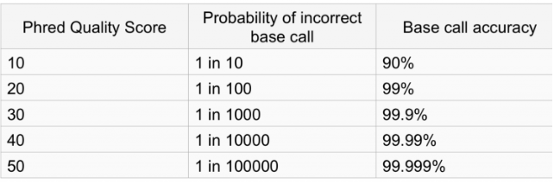
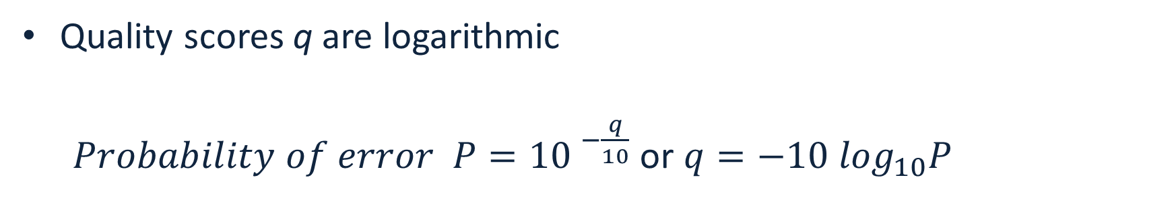
Quality score
Quality scores q are logarithmic
$Probability of error P={10 }^{−\frac{q}{10}}$ or $q=−10 \log_{10}P$
https://learn.gencore.bio.nyu.edu/ngs-file-formats/quality-scores/

Slide 8
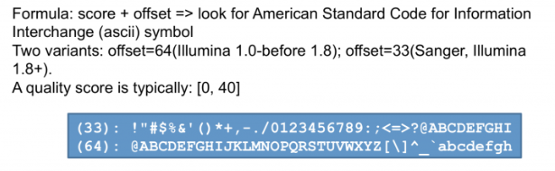
Phred33 vs Phred64 encoding
Phred (Phil's Read Editor^{[1]}) -- the name of the first program to compute quality scores in Sanger sequencing data by Phil Green
Quality scores q are encoded with characters
Offset may differ – most common now is 33 (Phred33)
https://learn.gencore.bio.nyu.edu/ngs-file-formats/quality-scores/

Slide 9
Fasta format
Header line: >seq_name attribute1 attribute2
Sequence, each line no longer than 80 characters (convention): AGCATAGACATATAGCAT AGATAGATCAGATAG
Optional accompanying file of quality scores

Slide 10
Example fasta format
>sequence1 tag1=value1
AGATAGATACAGATCAG
>sequence2 tag1=value1
AAGAATCATACACAAA

Slide 11
Fastq format
Each sequence definition starts with “@”, read name immediately follows
^@ line may contain more space-separated fields
Next set of lines is the sequence (ACGTN), no limit on the line length
New line starting with “+” ends sequence; read name may be duplicated after the “+”
Quality scores follow. Number of characters equal to the number of letters in the sequence
“@” symbol may appear in the quality scores!!!

Slide 12
Example fastq format
@read1 property=value someotherstuff
NAGCATGACATAGAC
+
D@JNDKJNDKSSSNS
@read2 property=value someotherstuff
NGAGATCATGACTAG
+
KIDBDHBJSHAJHS3

Slide 13
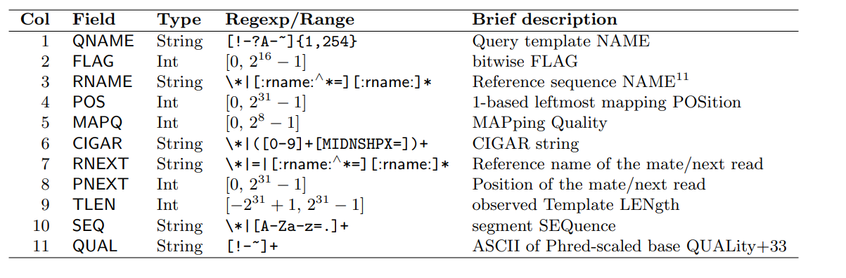
SAM format
Tab-separated file, human readable with the following columns
Missing or not defined values are *

Slide 14
SAM format
Tab-separated file, human readable with the following columns
Missing or not defined values are *

Slide 15
SAM/BAM and samtools
BAM files are compressed SAM files
Use samtools for SAM ⬄ BAM conversion:
Useful utility to work with SAM/BAM files
To view help type samtools –help
Most frequently used options
samtools view
samtools faidx/index
samtools sort

Slide 16
Lab 1: Convert fastq to fasta
Goal: write a python script that reads a fastq file from stdin, converts it to fasta and outputs to stdout; familiarize yourself with GradeScope
There may be one or more than one sequence in the fastq file
Name your program fastq_to_fasta.py
Do not assume that sequence/quality are on a single line. Remember: number of characters in the sequence (before line starting with “+”) specifies how many characters of quality you must read
Due date: September 5, 8:00pm.
Submit your code to GradeScope, it will be graded automatically right away, you have unlimited submission attempts until due date

Slide 17
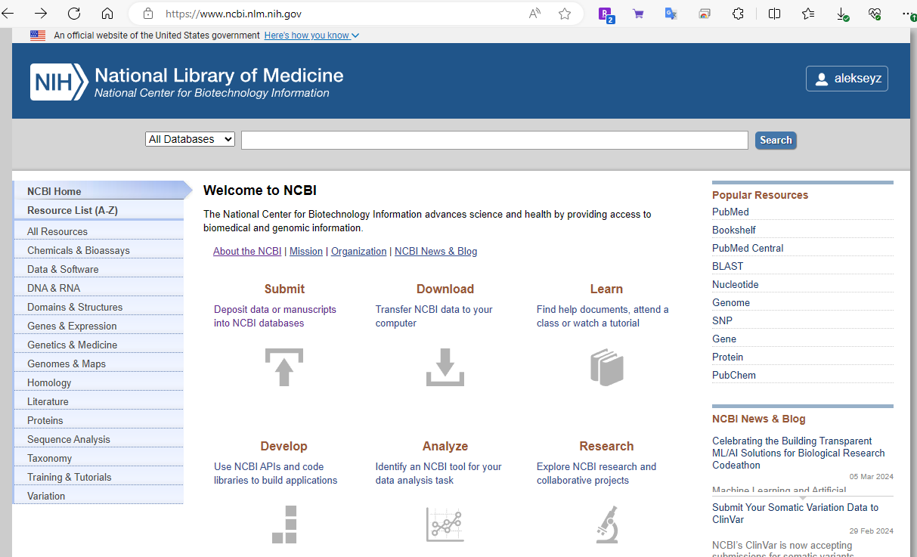
National Center for Biotechnology Information
National Center for Biotechnology Information (NCBI) hosts multiple databases:
GenBank: repository of draft genomes
RefSeq: repository of high quality genomes
Sequence Read Archive or the SRA: the biggest repository of the sequencing data
And many others (genes, proteins, literature, clinical trials, etc …)

Slide 18
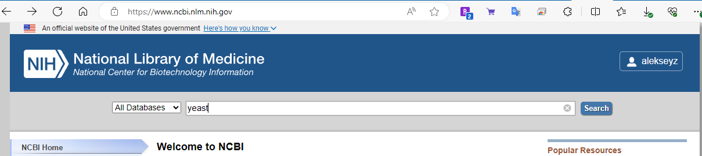
Finding information at NCBI

Slide 19
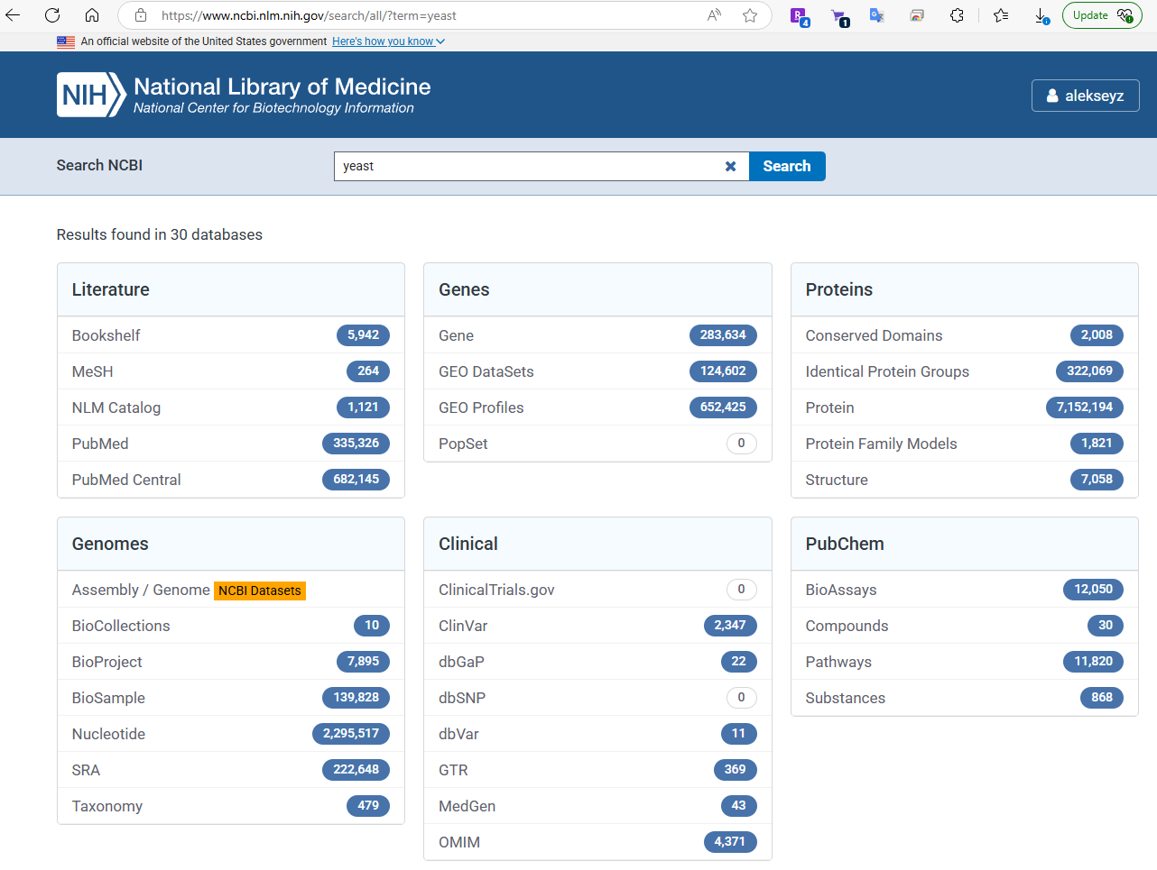
Finding information at NCBI

Slide 20
Finding information at NCBI

Slide 21
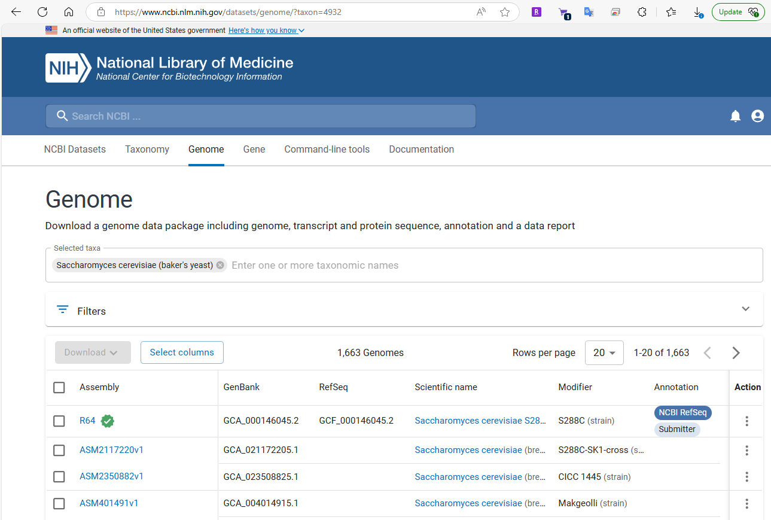
Finding information at NCBI:GenBank/RefSeq

Slide 22
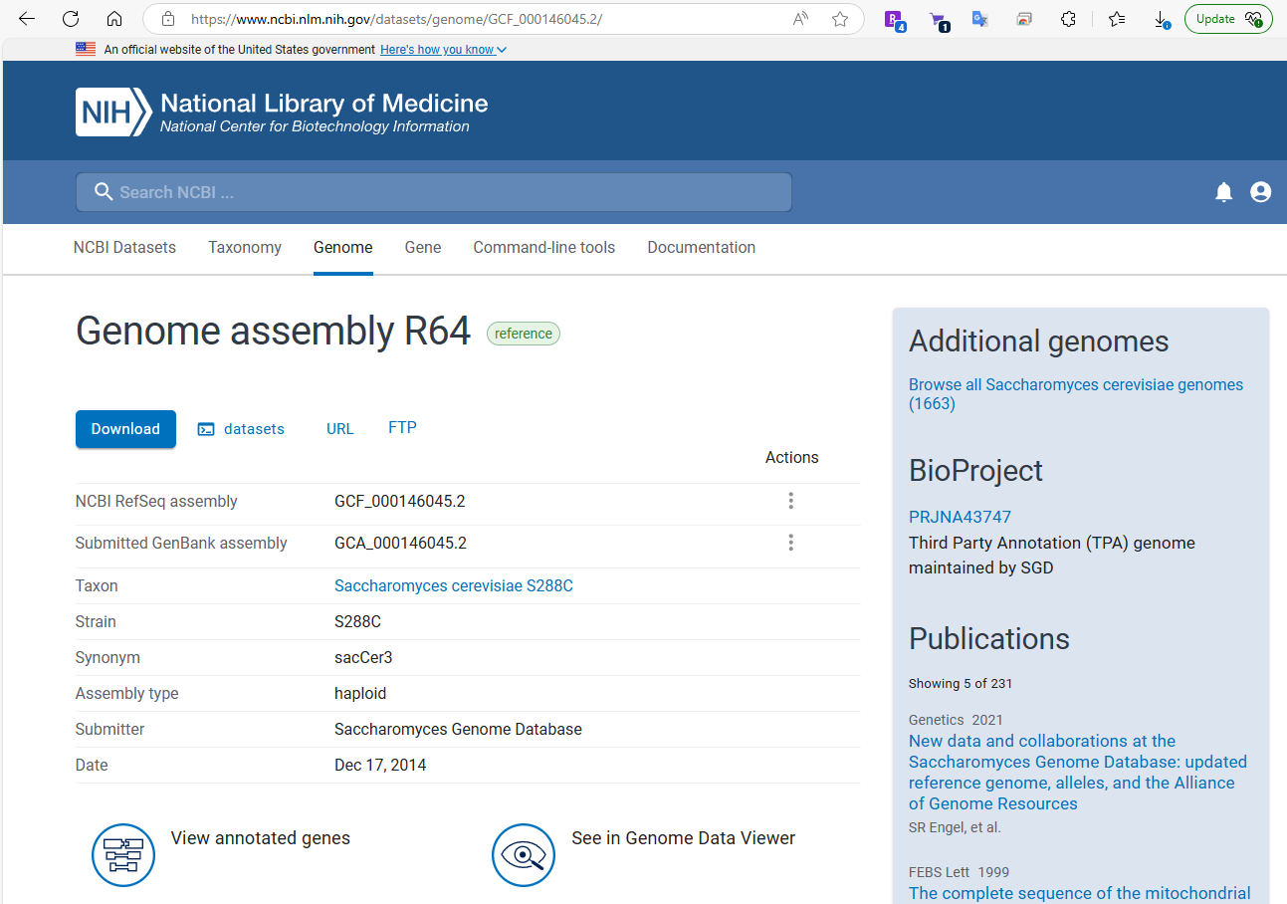
Finding information at NCBI:GenBank/RefSeq

Slide 23
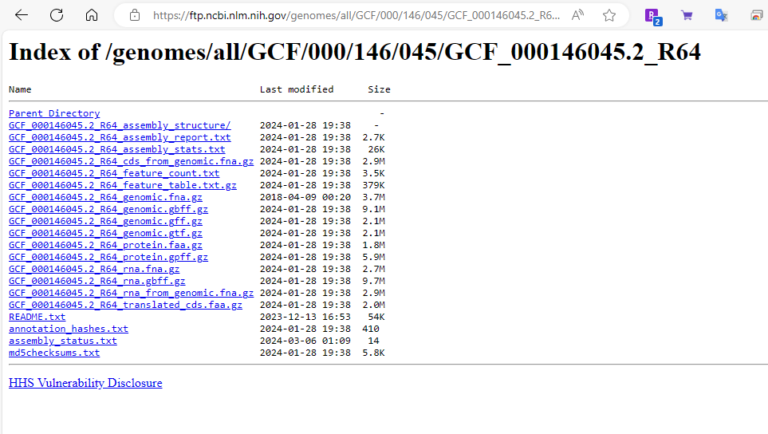
Finding information at NCBI:GenBank/RefSeq
Right-click on the link and choose “Copy link”
Then go to your terminal and type wget and paste the link:
wget paste_the_link_here

Slide 24
Finding information at NCBI:GenBank/RefSeq

Slide 25
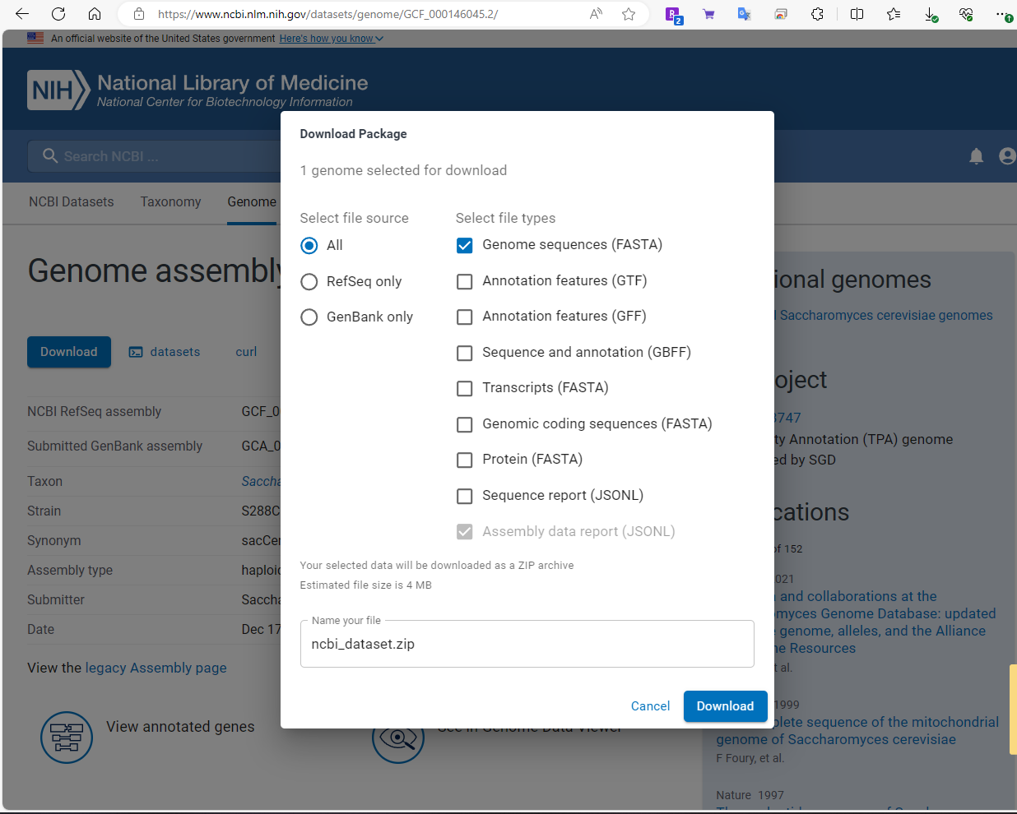
Finding information at NCBI:GenBank/RefSeq

Slide 26
Finding information at NCBI:GenBank/RefSeq

Slide 27
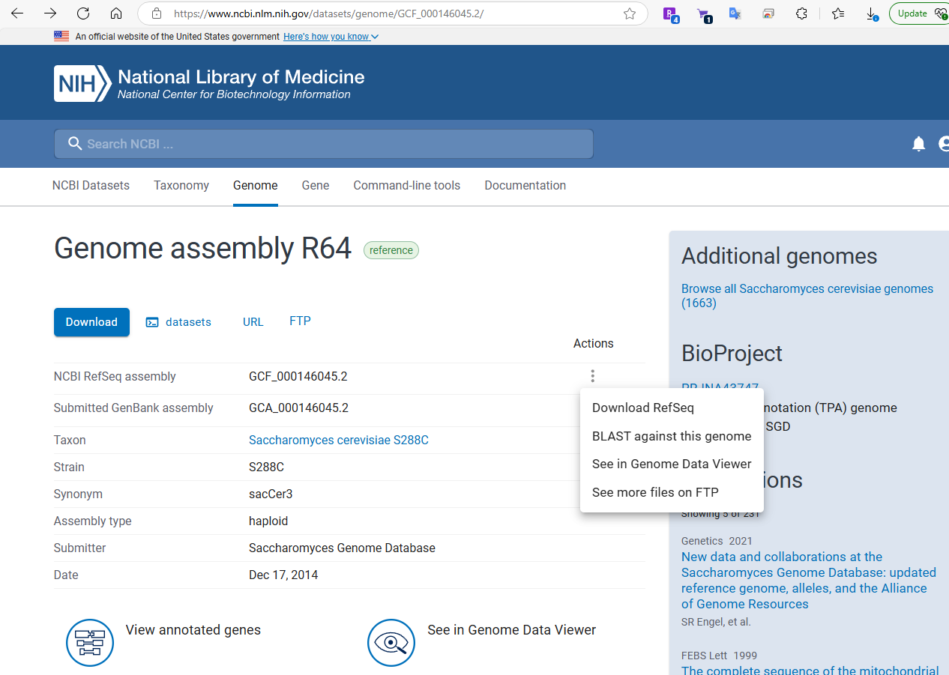
Finding information at NCBI:GenBank/RefSeq

Slide 28
Finding information at NCBI

Slide 29
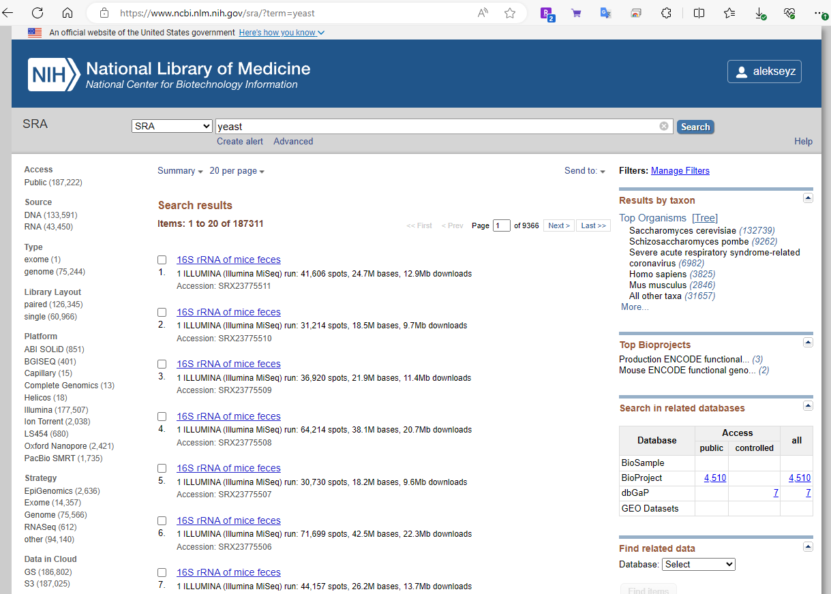
Finding information at NCBI:SRA

Slide 30
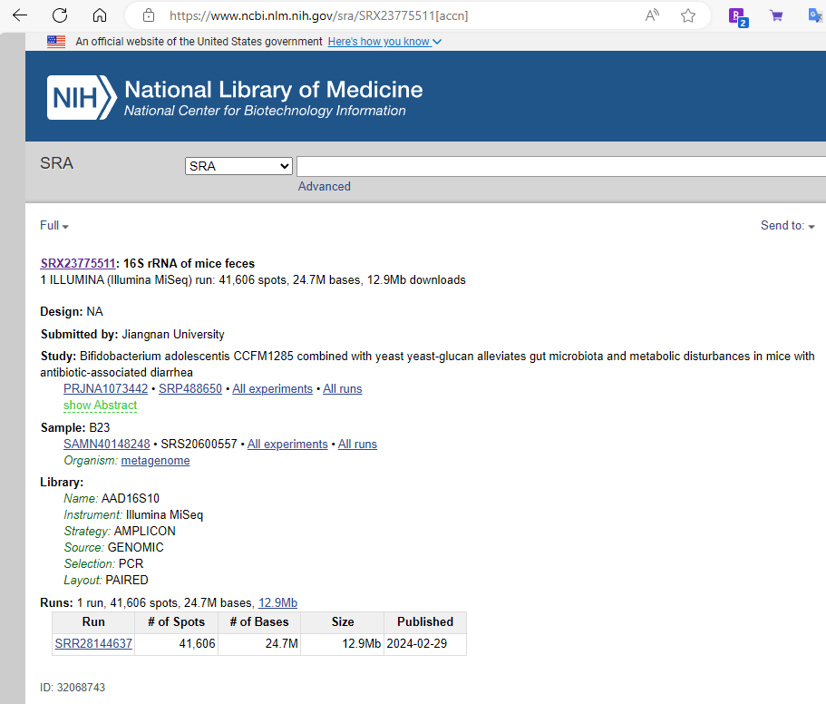
Finding information at NCBI:SRA

Slide 31
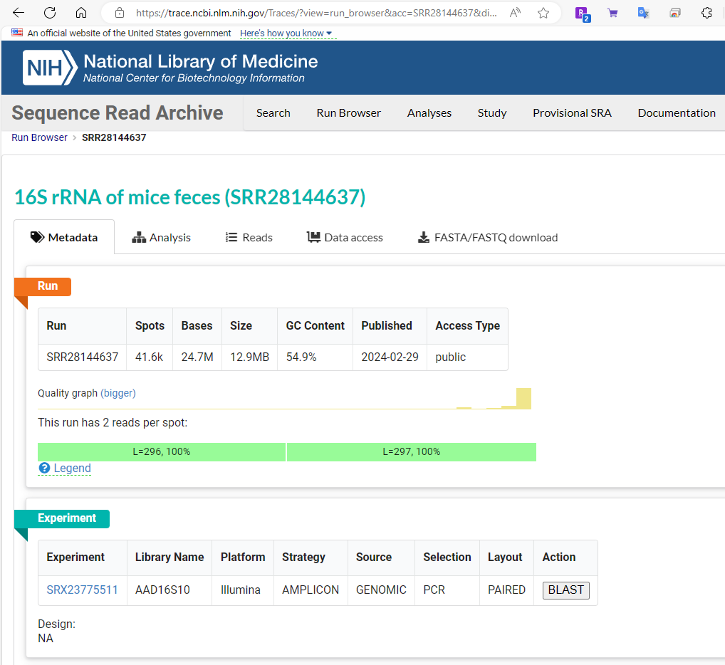
Downloading data from NCBI SRA: small sets
Using GUI at NCBI is the easiest way to download small data sets
For most data you have to use NCBI SRA toolkit

Slide 32
Downloading data from NCBI SRA

Slide 33
Using fastq-dump (part of sratoolkit)
sratoolkit is available from NCBI
fastq-dump is used to get data from NCBI SRA
fastq-dump --split-3 SRRXXXXXXXX
Produces files:
SRRXXXXXXXX_1.fastq – Illumina paired end forward reads
SRRXXXXXXXX_2.fastq and/or – Illumina paired end reverse reads
SRRXXXXXXXX.fastq – single-end reads

